Slide 1


VulnX: AI-Driven Code Intelligence Platform for Vulnerability Detection and Secure Code Optimization
Course: Compiler Design – CSA1421
Guided By: Dr. K. Pandi Kumar

Slide 2
1. Introduction
VulnX is an AI-driven platform for source code security analysis.
Identifies potential vulnerabilities and unsafe coding practices.
Uses lexical, syntax, and semantic analysis with AST traversal.
Highlights risky code and recommends safer alternatives.
Helps developers improve software security.
VulnX detects potential security vulnerabilities and unsafe coding practices in source code.
It uses compiler techniques and AI-assisted guidance to recommend safer coding alternatives.

Slide 3
2. Problem Statement
Developers may introduce security vulnerabilities while writing source code.
Manual code reviews can be time-consuming and may overlook risky patterns.
Traditional compilers primarily focus on checking and translating code rather than comprehensive security analysis.
Developers may struggle to understand why a particular coding pattern is unsafe.
A platform is needed to detect selected security risks and recommend safer coding practices.

Slide 4
3. Objective
To analyze source code using compiler design techniques.
To identify potential security vulnerabilities and unsafe coding patterns.
To highlight vulnerable code sections with their corresponding line numbers.
To provide understandable explanations of security risks.
To recommend safer coding alternatives using rule-based analysis and optional AI assistance.
To generate security reports and compare original code with suggested improvements.

Slide 5
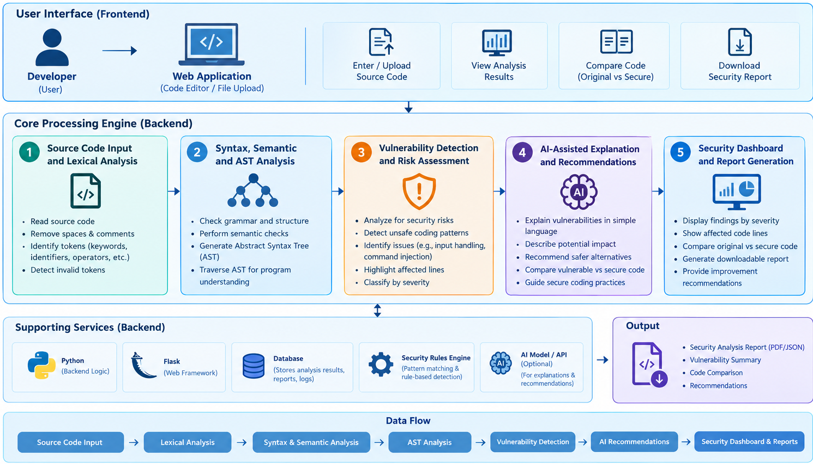
4. System Architecture

Slide 6
THANK YOU

